Slide 1


Stock Albuterol as a Movement
Missouri leads the way with RESCUE

Slide 2



Today’s Presenters
Chris Martinez, MBA, CFRE
CEO
Naomi Soto, MPP
Director of Programs

Slide 3
Learning Objectives
History of the Asthma and Allergy Foundation of America
Context of Stock Albuterol across the US
Overview of MO House Bill 1188
Clinical guidance on asthma episodes
RESCUE Missouri Schools
Questions
Notes:
We’ll start today’s training by reviewing House Bill 1188, which is the legislation that allows schools to maintain a supply of undesignated stock asthma rescue medication in schools.
Then we’ll consider the state of asthma in Missouri, particularly among children, and discuss why this kind of legislation is important to help reduce asthma episodes or emergencies (sometimes referred to as asthma attacks).
Next, we’ll discuss logistics and implementation. We’ll discuss how this fits into the IL State Board of Education’s model asthma emergency response protocol and what it means to have a standing order in place that allows personnel to administer stock asthma medication, review a model standing order that provides information about how and when to administer stock asthma medication, and discuss where and how the medication should be stored. Finally, we’ll discuss clinical guidance and how to recognize when a student is experiencing respiratory distress.
Finally, we’ll end with guidance on how to recognize respiratory distress and when a student may need assistance.

Slide 4
AAFA History
National office founded in 1953
St. Louis Chapter founded in 1981
BREATH Program
  Legacy prescription assistance program
RESCUE Program
  Stock albuterol program for schools in the
  St. Louis metro area
More recently: asthma and allergy diagnosis kits

Slide 5
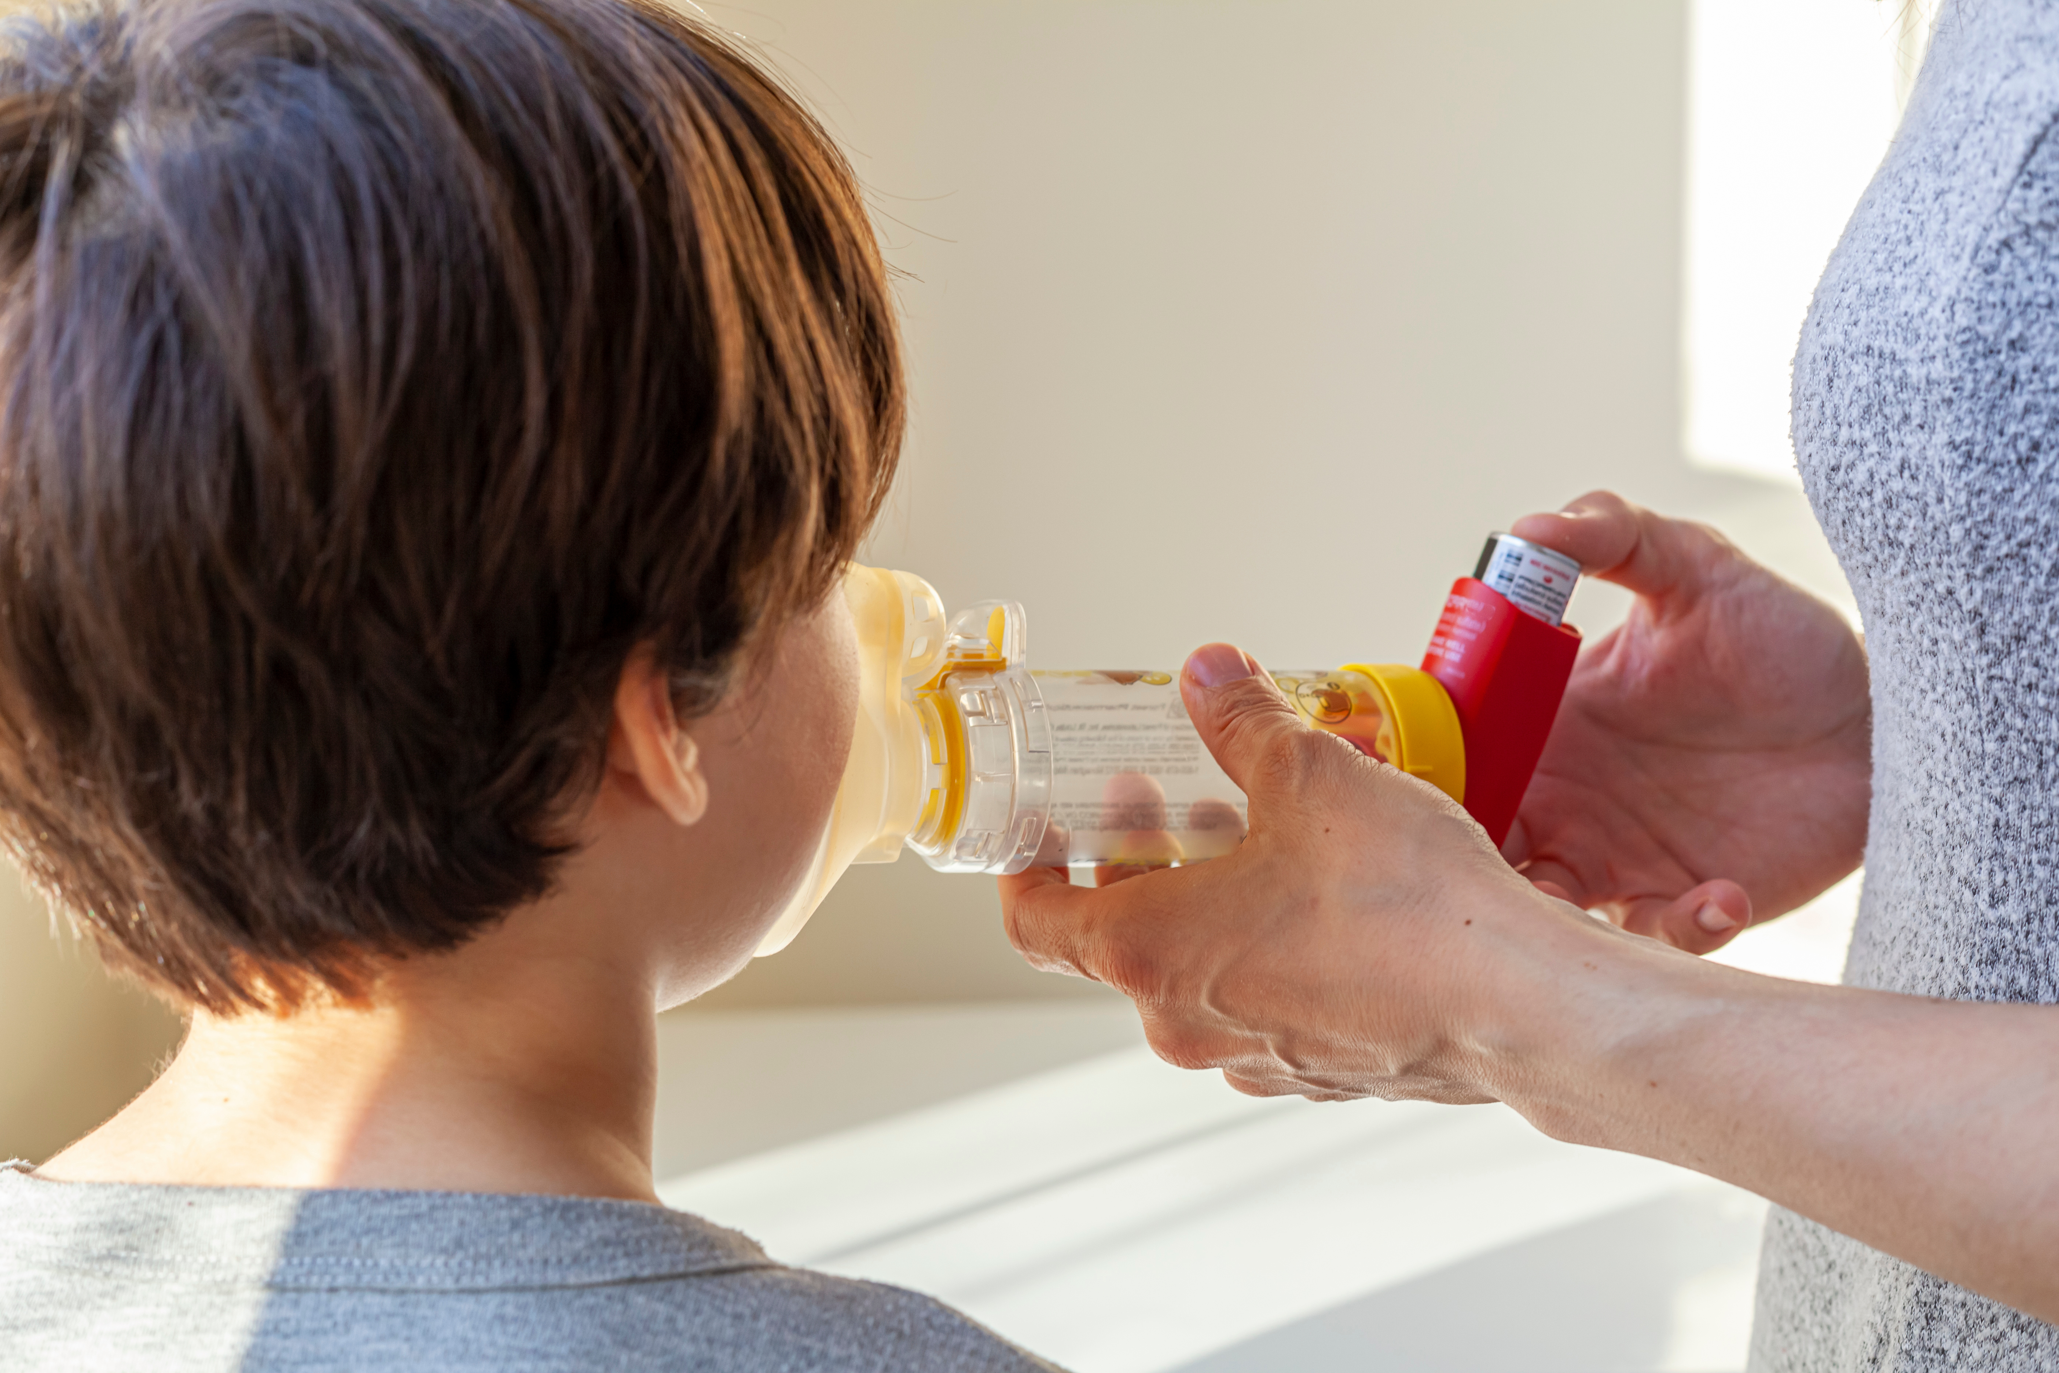
Stock Albuterol in America

Slide 6
HR 2468
School-Based Allergies and Asthma Management Program Act
Jan 2021, School-Based Allergies and Asthma Management Program Act became law
Encourages states to improve allergy and asthma care in schools by giving preference for federal grants to states that adopt certain management programs and policies.

Slide 7
HR 2468
School-Based Allergies and Asthma Management Program Act
States can earn financial rewards for putting the following in place:
  Methods to identify all students who have allergies or asthma
  Create individual student action plans
  Require school nurses or on-site trained staff during operating hours to administer medicines for both asthma and allergies
  Asthma and allergy training education for school staff
  Efforts to reduce indoor asthma and allergy triggers
  Coordinate management of care with families and health care providers

Slide 8
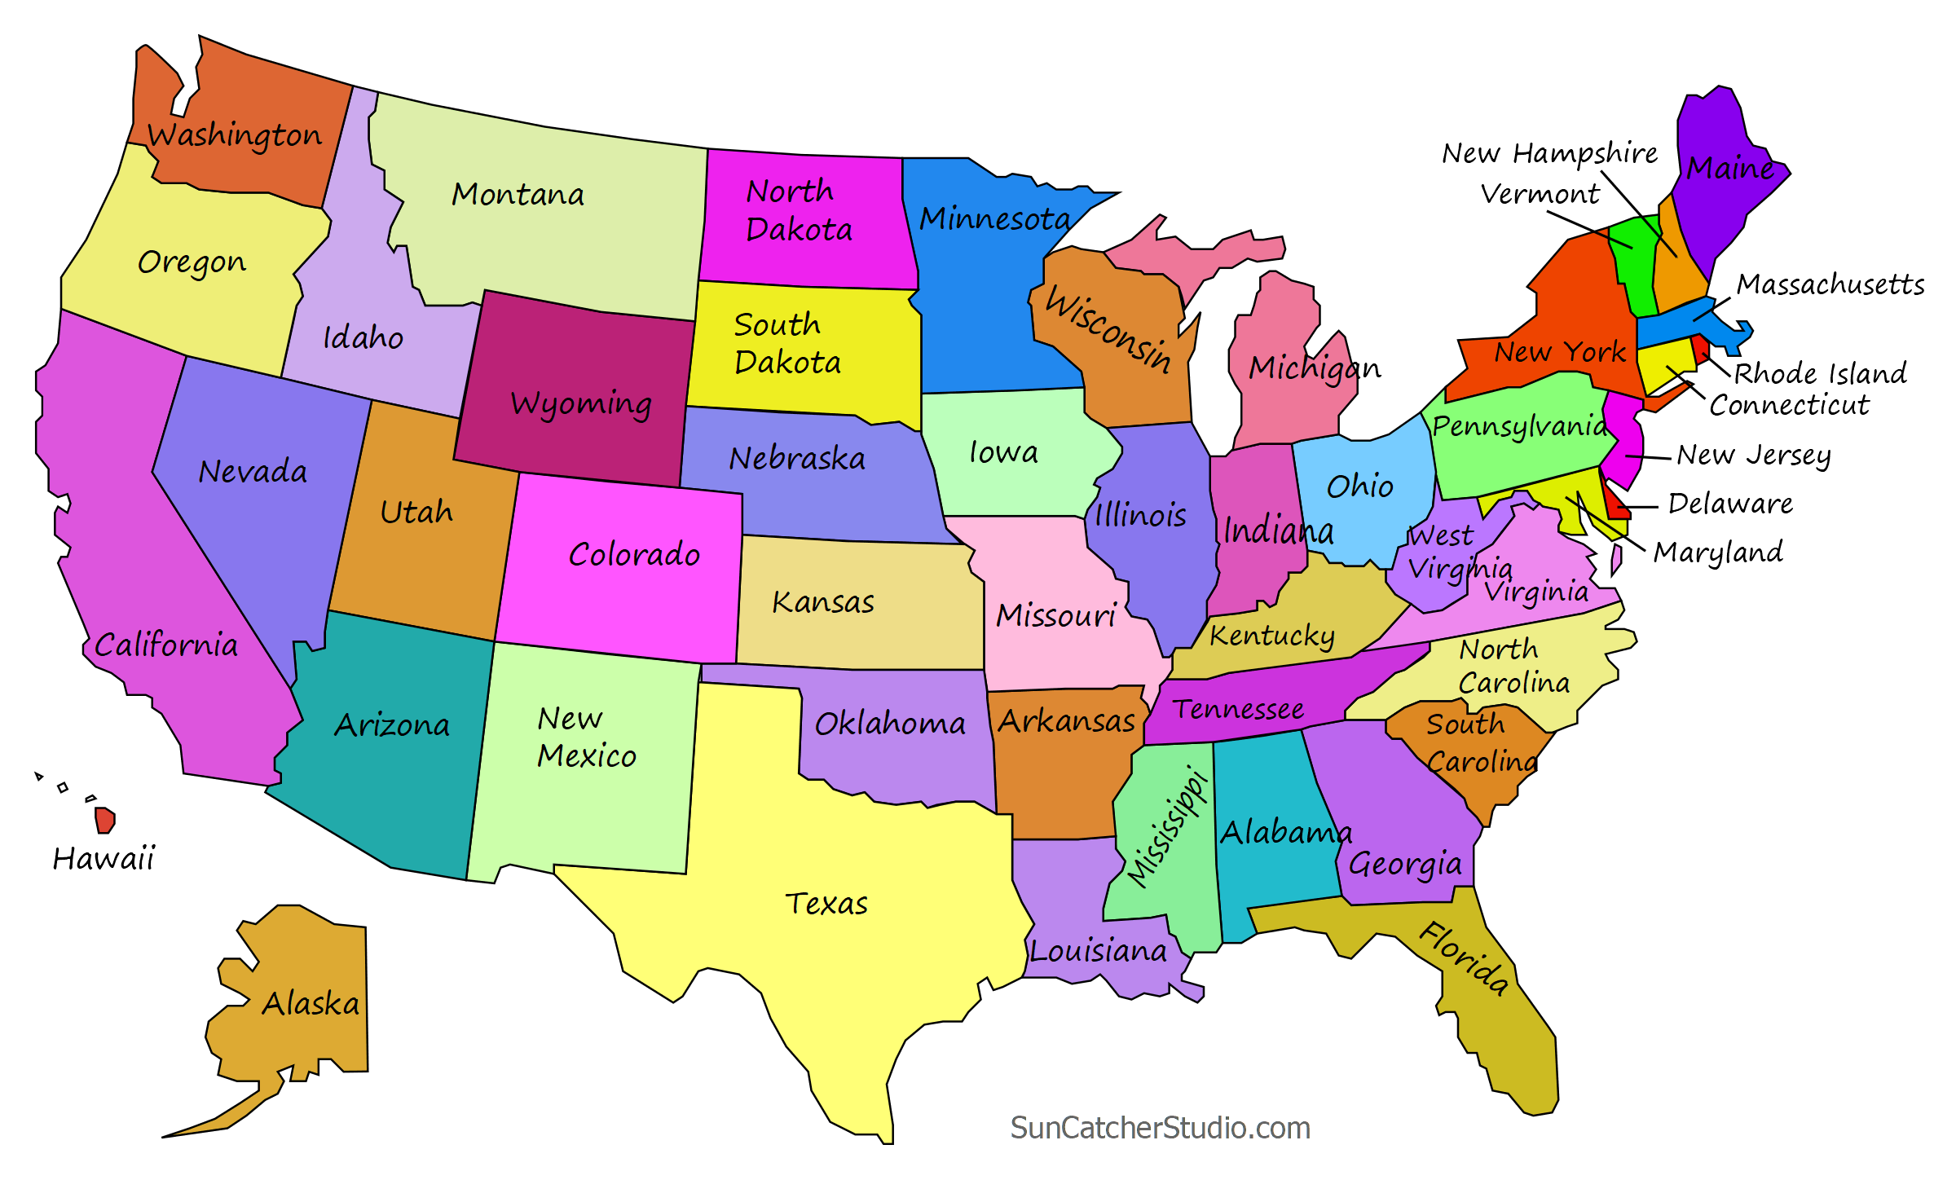
Stock Albuterol in America
Patchwork of coverage of stock medication legislation

Slide 9
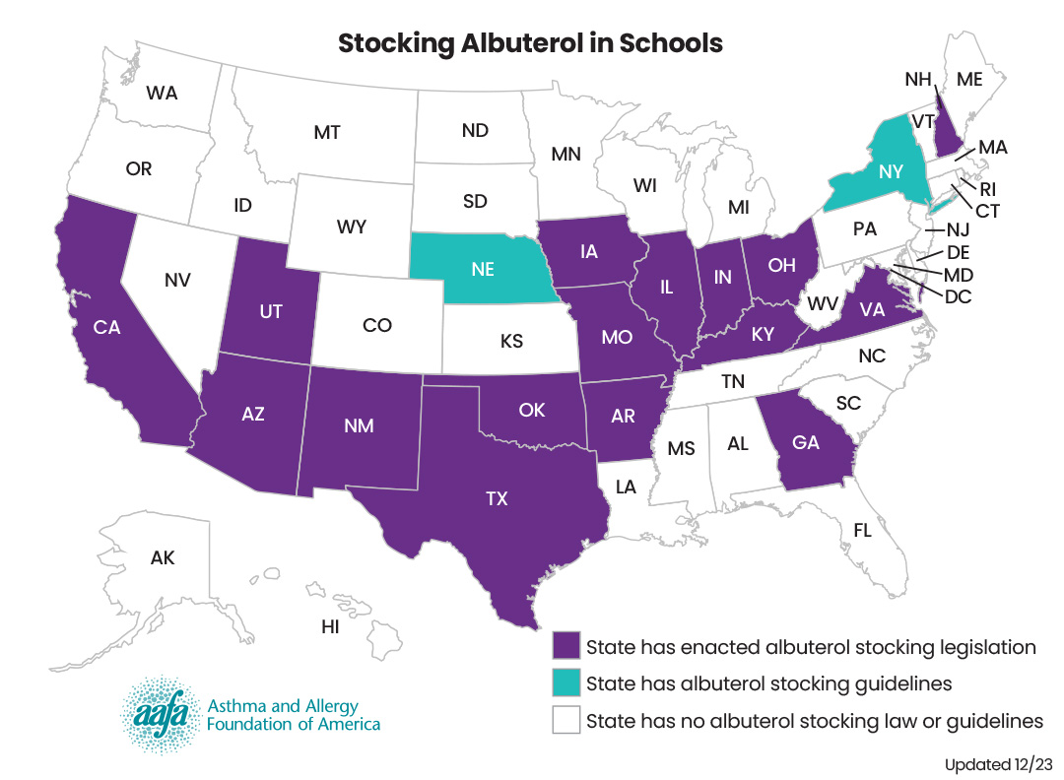
Stock Albuterol in America
18 states have passed stock albuterol laws
California was the most recent one state – passed October 2023

Slide 10
Stock Albuterol in Missouri
House Bill 1188
x
Authorizes schools to stock “undesignated” asthma rescue medication and authorizes school nurses and other trained school staff to administer the medication in the event of respiratory distress or other asthma symptoms.
School must obtain a written prescription and a signed standing order from a healthcare provider
* Not limited to students with asthma diagnosis.
x
Notes:
In 2011, the Missouri legislature passed HB 1188. This amended the revised statues to have undesignated, or stock, asthma rescue medication. In the past, students who were experiencing an asthma episode could only use asthma medication that was prescribed to them and which they had stored at the school or carried on their person. If a student had symptoms of respiratory distress but did not have asthma medication at school, the school was required to call 911.
This legislation allows schools to keep a stock of undesignated asthma rescue medication (which means medication that is not prescribed for any specific student) for use when there is an asthma emergency. Students experiencing respiratory distress can use this stock medication even if they do not have a prescribed inhaler or other medication at school. The law permits school nurses and other trained personnel to provide undesignated medication to a student to self administer (meaning they use the medication themselves without your assistance) or to administer the undesignated medication directly to a student. This should be done in accordance with the student’s Individual Health Action Plan or Asthma Action Plan, if they have one on file. However, the legislation also allows trained personnel to administer the medication to any person believed to be experiencing respiratory distress regardless of if they have an Individual Health Action Plan or Asthma Action Plan on file.
The law does not REQUIRE that schools provide undesignated asthma medication, but it permits schools to do so.
The nurse or trained personnel can administer the medication while in school
The school must obtain a written prescription from a healthcare provider for undesignated asthma medication. In addition to the prescription, the provider shall sign an order for the school nurse or trained personnel to be able to administer the medication. A standing protocol may be issued by a physician, physician assistant, or nurse practitioner.

Slide 11
Childhood Asthma in Missouri
Nearly 120,000+ children in Missouri have asthma.
55 percent of these children have asthma that is considered “uncontrollable” or “unmanaged” and are likely to have at least one asthma episode at school each year.
Asthma is a leading cause of school absenteeism due to chronic disease.
The average hospital visit for an asthma episode is $1,568.

Slide 12
Missouri and Illinois as national leaders
In 2022, Missouri and Illinois became leaders in the country by establishing funding mechanisms to make stock albuterol a reality across their states
Early 2023
  MO opened an RFP through DESE.
  IL appropriated funding to the Department of Human Services
Many states across the country are actively exploring funding options. Including, TX, IA, AR, and AZ
x

Slide 13
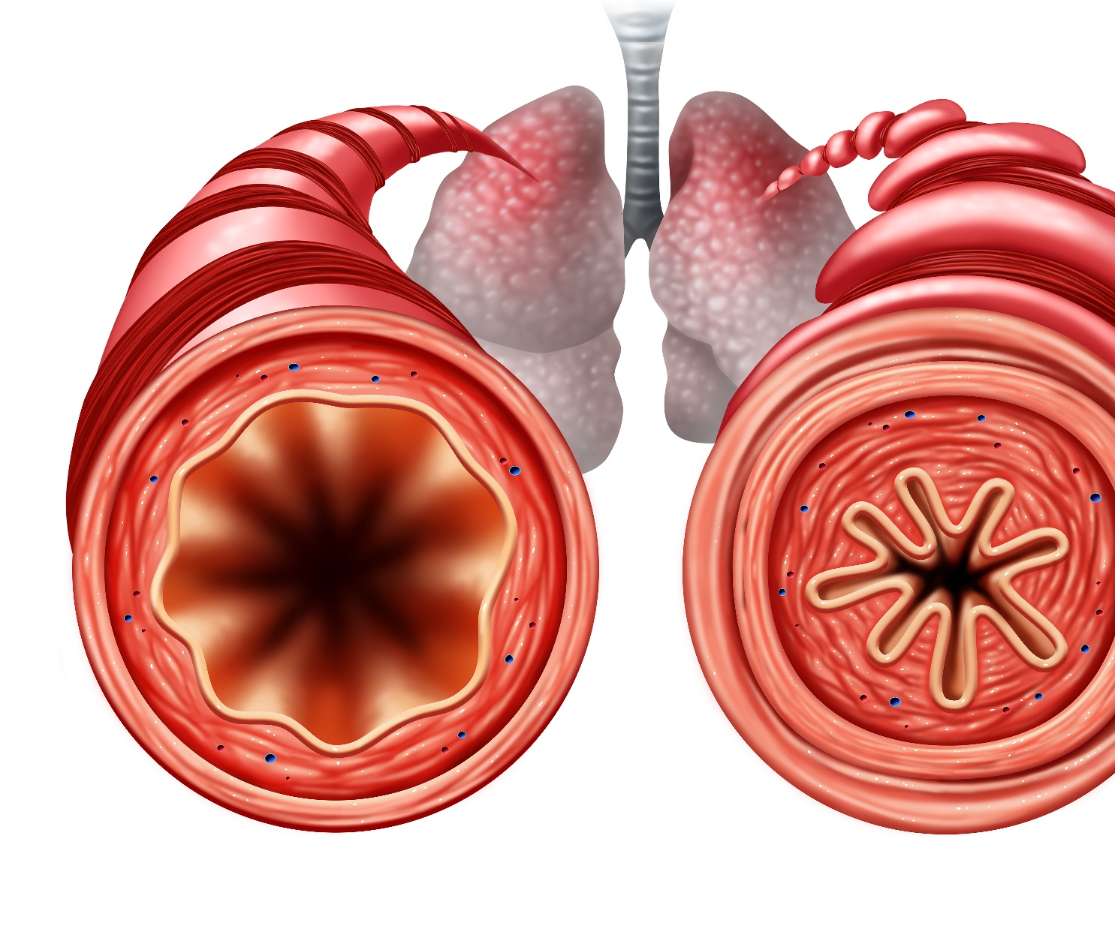
Asthma and Respiratory Distress

Slide 14
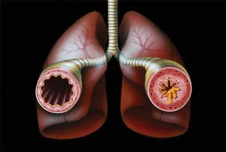
Asthma
Lifelong condition that affects airways
  Airways narrow and swell
  Airways may produce extra mucus

Slide 15
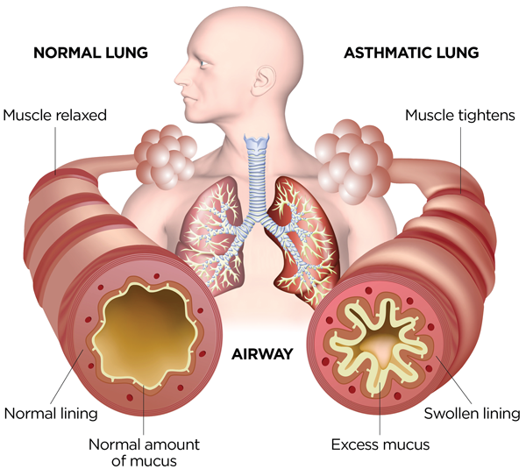
Respiratory distress
Wheezing
Coughing
Shortness of breath
Chest tightness
Trouble breathing with exercise
Image source: https://community.aafa.org/blog/what-happens-in-your-airways-when-you-have-asthma

Slide 16
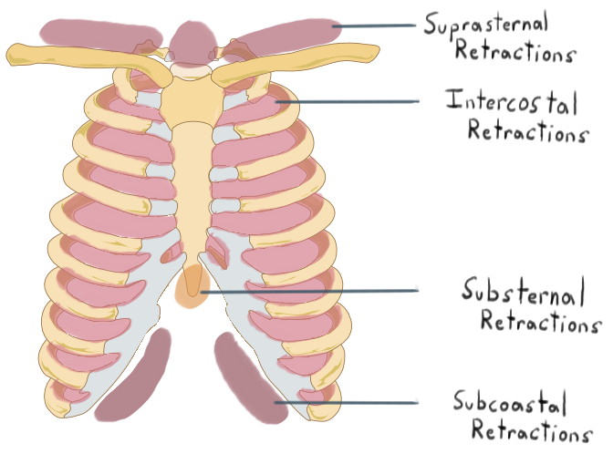
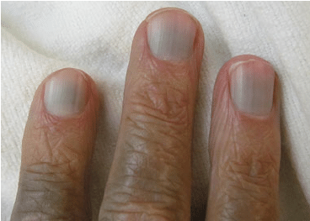
Respiratory distress: severe or worsening
Breathing hard and fast
Nostrils open wide
Trouble walking
Trouble talking
Retractions
Blue or gray lips and nail beds
Medication does not help in 15-20 minutes

Slide 17
Responding to respiratory distress
Stay calm
Assess child
Provide medicine
Monitor child for changes
Contact parents and/or 911
Notes:
Stay with the child at all times

Slide 18
Medication Storage
Undesignated albuterol should be stored in a secure location that is inaccessible to students or undesignated personnel but should not be locked during school day.
Location(s) should be clearly marked and readily accessible under supervision of school nurse.
  In absence of a school nurse, it should be monitored by designated, trained personnel.

Slide 19
Medication Storage
Medication should be stored in a place that is protected from direct sunlight and freezing temperatures.
  In general, medication should be kept between 36 to 77 degrees Fahrenheit.
School leadership, in consultation with school nurse, should notify all trained personnel on the appointed location(s) of the school’s undesignated asthma medication.

Slide 20

RESCUE Missouri Schools
Standing Order
Notes:
***STRONGLY CONSIDER CHANGING THIS PICTURE SO IT SHOULD INHALER WITH SPACER

Slide 21
Asthma Emergency Response Protocol
Response should be delivered in accordance with district protocol and/or the RESCUE standing order and protocol.
Outlines steps to take if a student is experiencing symptoms of an asthma episode.
All school districts should have a protocol in place; review your school district’s protocol or review the RESCUE protocol.
Notes:
All school districts are required to have their own asthma emergency response protocol, which outlines the steps to take if a student is experiencing symptoms of an asthma episode.
The following slides use the ISBE model emergency response protocol. Most school districts use this protocol but confirm with your district that this is the case. If not, be sure to review your districts protocol to determine how it differs.
In the next few slides, I will walk through the ISBE protocol in detail. You can pull up this protocol, available online, to follow along. https://www.isbe.net/Documents/asthma_response_protocol.pdf

Slide 22
Administration
In absence of a licensed school nurse, only personnel who have been trained to recognize the symptoms of respiratory distress/asthma symptoms and correctly administer asthma medication may administer undesignated asthma medication with a spacer.
The undesignated asthma medication is to be given to a person that trained personnel believe in good faith to be experiencing respiratory distress while in school
Notes:
The ISBE model protocol begins by listing the equipment and supplies needed to administer medication. This includes the quick-relief medication itself. Many students carry their own inhaler with them, while others are stored in a secure location. If that is the case, you or other trained personnel will need to get the student’s medication. This is also true if you are using undesignated medication.
You’ll also need to have any additional equipment or supplies necessary for administering the asthma medication, such as a spacer or nebulizer.
Finally, if available, you can reference the student’s asthma action plan.

Slide 23
STANDARD PROCEDURES AND PROTOCOLS FOR EMERGENCY USE
Notes:
***STRONGLY CONSIDER CHANGING THIS PICTURE SO IT SHOULD INHALER WITH SPACER

Slide 24

Caution Zone

Slide 25

Danger Zone (severe asthma episode)

Slide 26
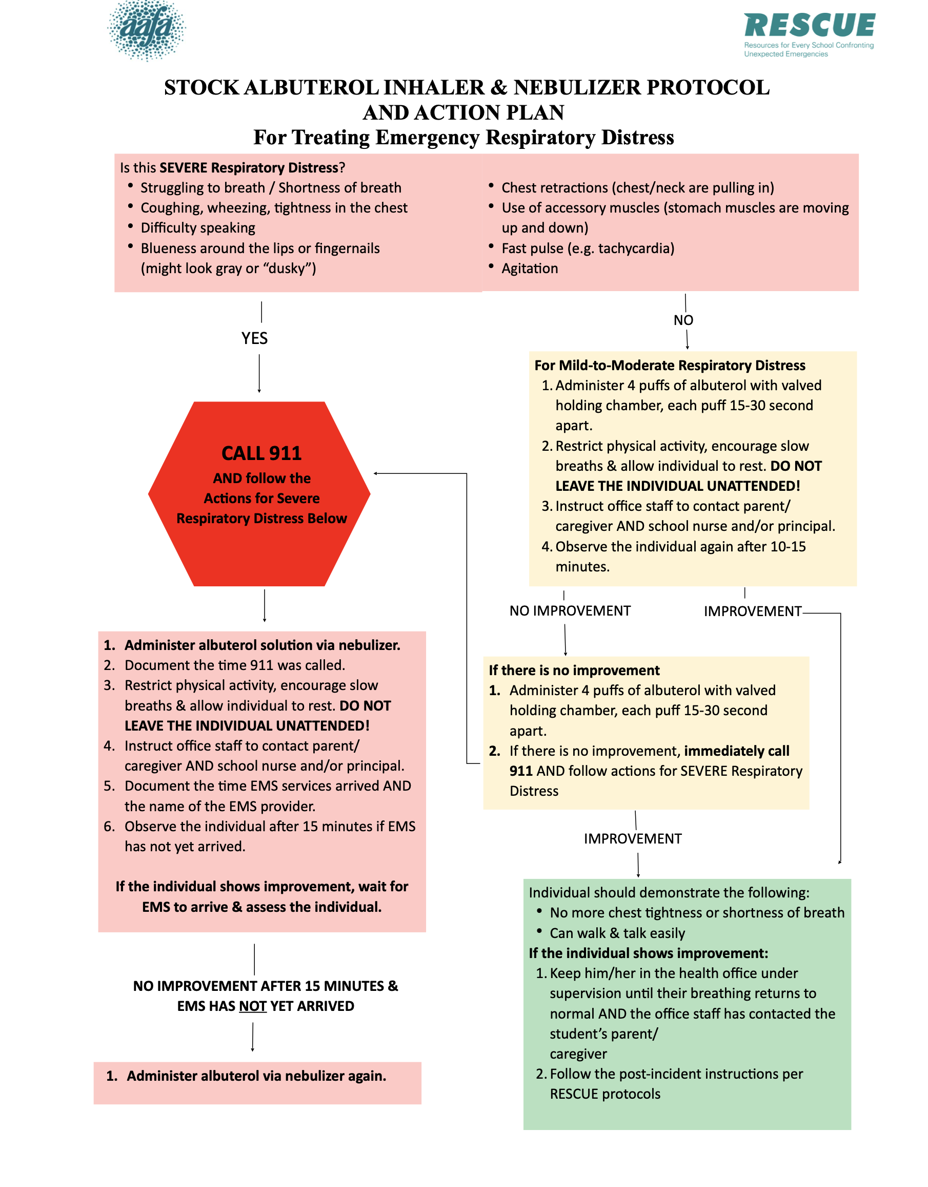
Stock Albuterol Inhaler
& Nebulizer
Protocol and Action Plan
Condition

Slide 27
Stock Albuterol Inhaler
& Nebulizer Protocol and Action Plan
Condition

Slide 28
Stock Albuterol Inhaler
& Nebulizer Protocol and Action Plan
Condition

Slide 29
Stock Albuterol Inhaler
& Nebulizer Protocol and Action Plan
Condition

Slide 30
Stock Albuterol Inhaler
& Nebulizer Protocol and Action Plan
Condition

Slide 31
Condition

Slide 32
Condition

Slide 33
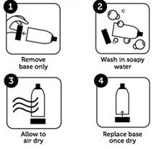

Cleaning Protocol
Use alcohol (or school designated) wipes for mouthpieces
Wipe clean
If piece gets wet, make sure has completely dried before next use
Spacers
Mouthpieces
Mark with date and place in designated area to indicate DO NOT USE for 10 days

Slide 34
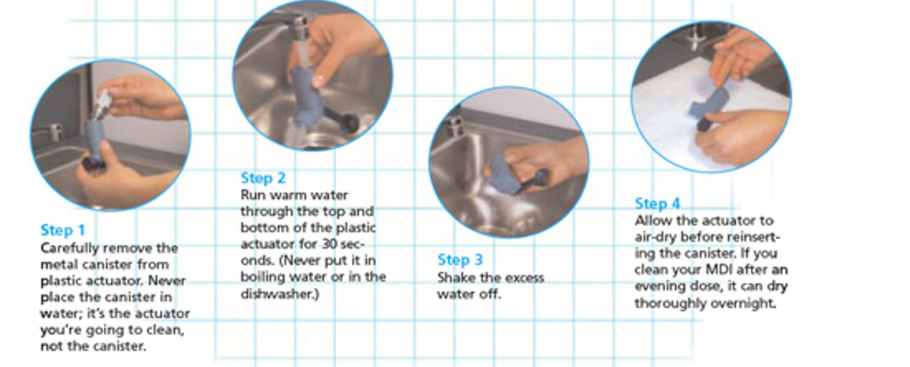
Cleaning Protocol
Meter-Dose Inhalers

Slide 35
The RESCUE Missouri Schools Program
Resources for
Every
School
Confronting
Unexpected
Emergencies

Slide 36
History of RESCUE
AAFA has been running this program in the St. Louis metro area and southern Illinois for the last 12 years. School nurse provides vital tools necessary during asthma emergencies
92%
of kids returned to the classroom after using a piece of AAFA equipment and medication during an asthma emergency
Notes:
Your school will have a process in place for notifying you of an asthma emergency that may require the use of undesignated asthma medication. Please check with your local administration on these details, as they will vary from school to school.
Your school or district should offer a local training that addresses
HOW to alert all trained personnel of an incident when it occurs
WHO to notify following an incident that requires the use of undesignated asthma medication
WHO is responsible to report to ISBE
HOW medication dose is restocked and ready for the next time

Slide 37
Reality check
RESCUE
School Districts
Medical Providers
Pharma
Medical equipment vendors
allowance access
Stock albuterol can only save lives if staff have access to it.
AAFA as the facilitator
Notes:
Other important stakeholders include legislators and other pediatric and respiratory experts

Slide 38
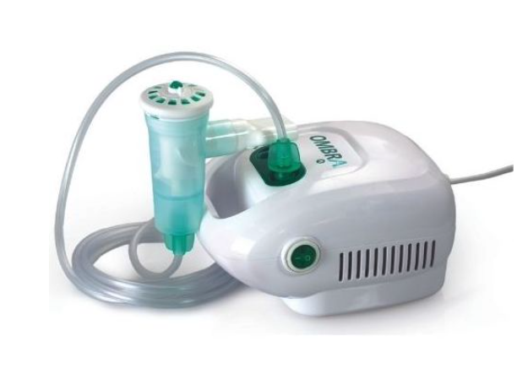
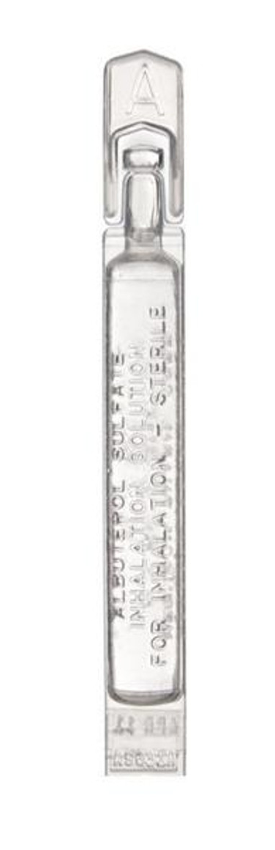

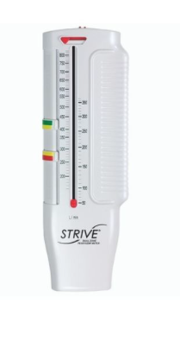
Medication & Equipment in
RESCUE Missouri Schools, SY 2023-2024
Metered dose inhaler
Aerochamber Plus Flow-Vu Plastic spacer
MC300 Nebulizer
Mouthpiece and tubing
Aeroeclipse Nebulizer with OMBRA Compressor
Albuterol solution
Lite Aires
Paper spacer
Strive Peak Flow Meter
Storage tote bag
Notes:
Other important stakeholders include legislators and other pediatric and respiratory experts

Slide 39
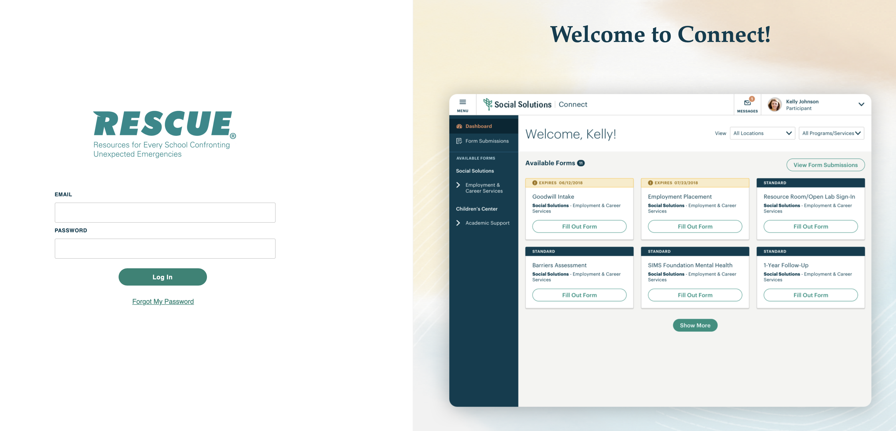
The RESCUE Portal

Slide 40
RESCUE Portal
https://bit.ly/RESCUE-MO-Nurse
If you’ve already filled out a Nurse Profile: Register for RESCUE Connect
If you haven’t yet filled out a Nurse Profile, we can do it for you TODAY.
Register for RESCUE Connect Portal
Report Usage on RESCUE Connect
Notes:
Other important stakeholders include legislators and other pediatric and respiratory experts

Slide 41
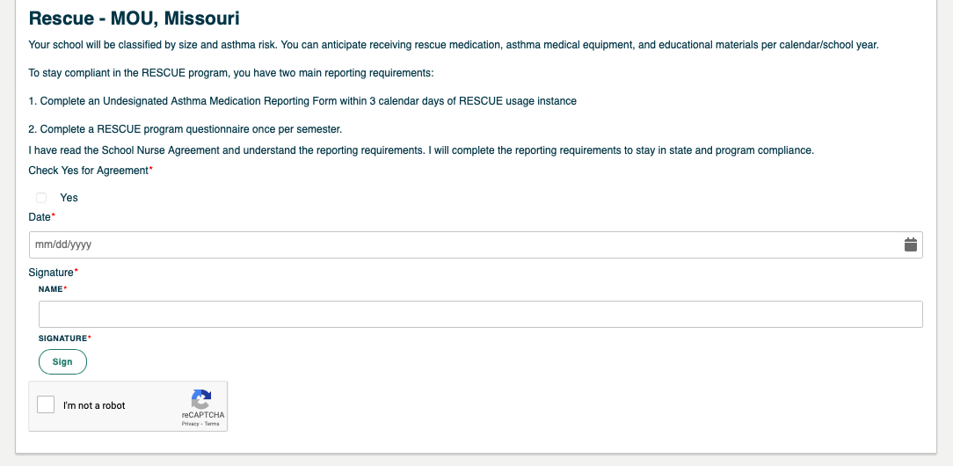
MOU Agreement
https://bit.ly/RESCUE-MO-Nurse
Notes:
Other important stakeholders include legislators and other pediatric and respiratory experts

Slide 42
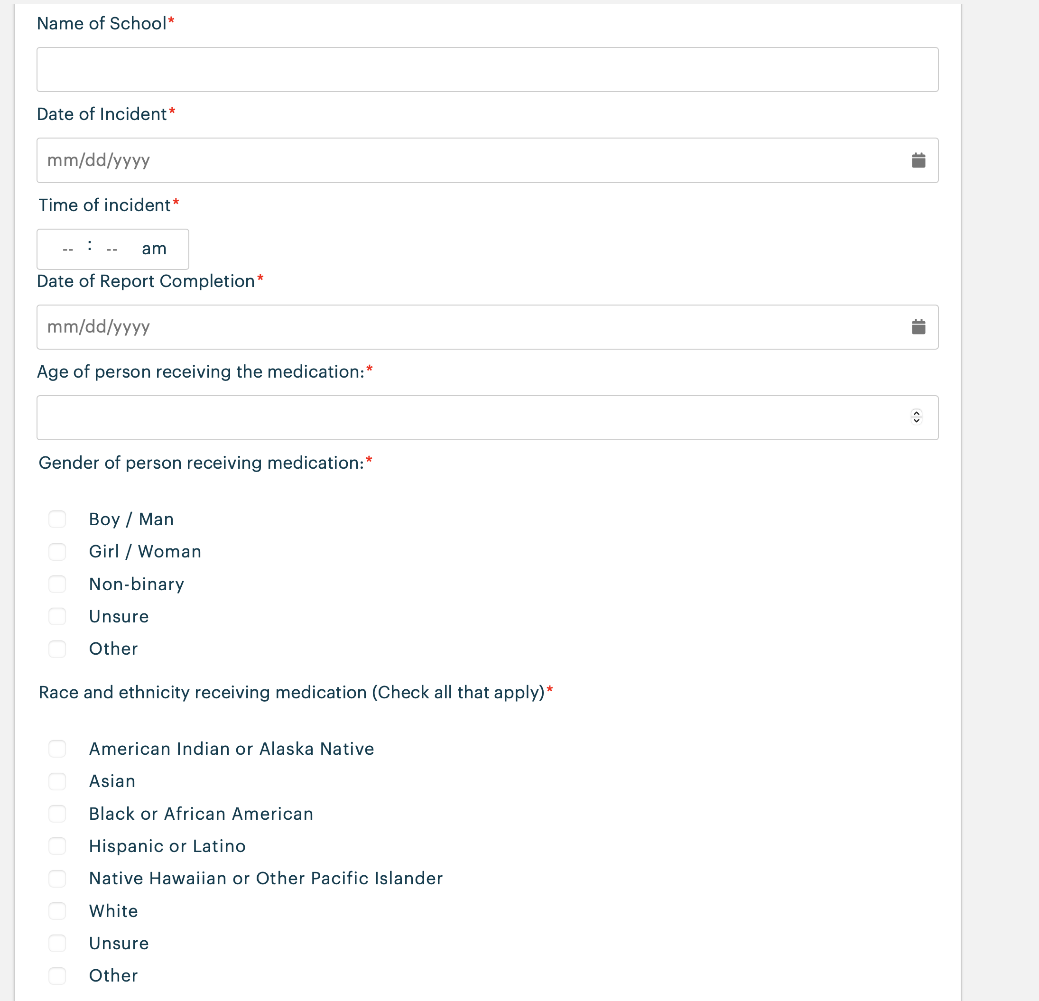
AAFA Undesignated Asthma Medication Reporting Form
Notes:
Other important stakeholders include legislators and other pediatric and respiratory experts

Slide 43
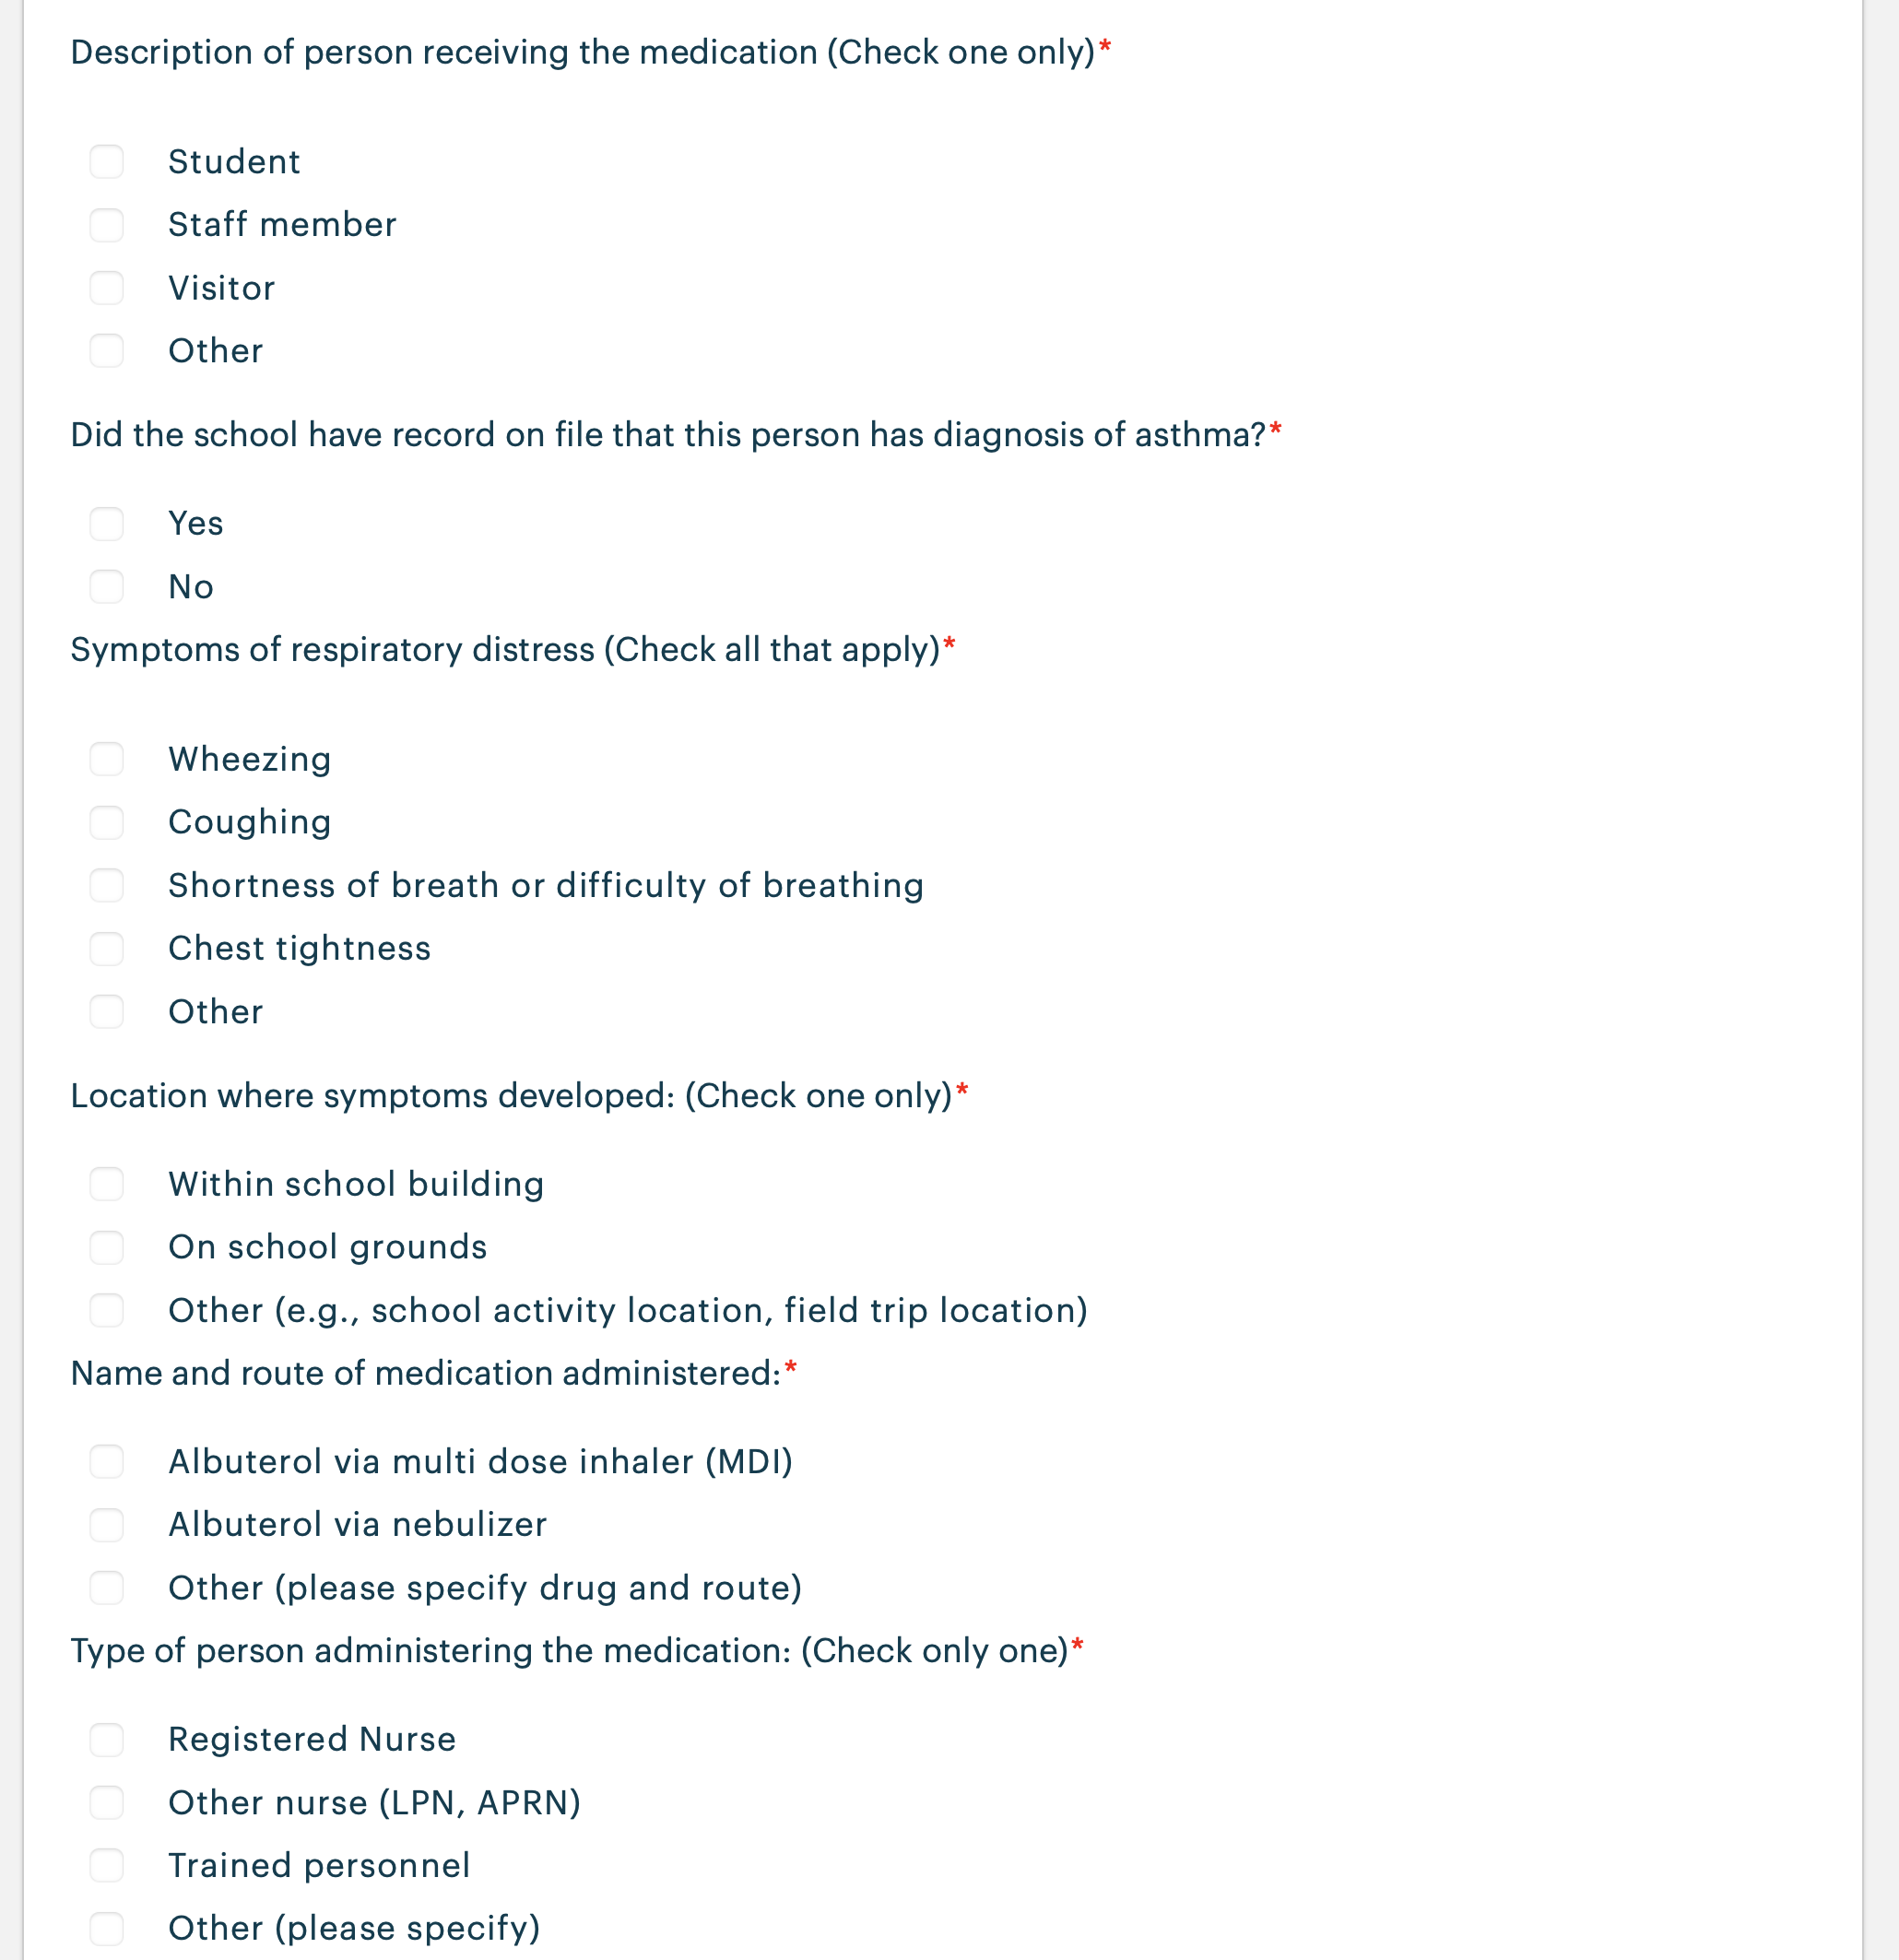
AAFA Undesignated Asthma Medication Reporting Form
Notes:
Other important stakeholders include legislators and other pediatric and respiratory experts

Slide 44
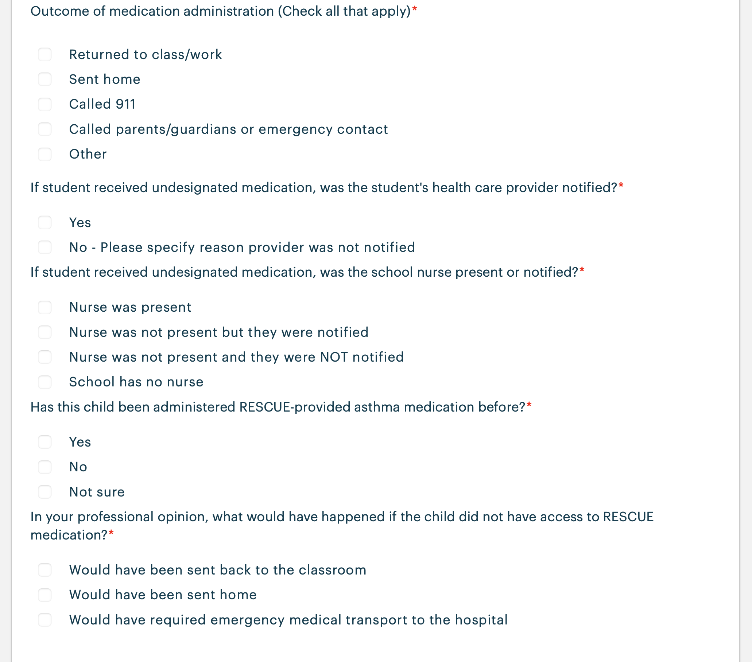
AAFA Undesignated Asthma Medication Reporting Form
Notes:
Other important stakeholders include legislators and other pediatric and respiratory experts

Slide 45
Questions?
rescue@aafastl.org

